Slide 1
Automatic Speech Recognition for Sanskrit Vedas using Wav2Vec 2.0
By Lambu Kushi Reddy

Slide 2
Contents:
Introduction
Labelled Data Preparation
Data Preprocessing
Challenges faced during Audio – Text Alignment.
Exploratory Data Analysis
Transliterating Devanagari Script to IAST
Finetuning Wav2Vec 2.0
Results
Conclusion

Slide 3
Introduction
1. Only 1% of the world’s languages are thought to contain the bare minimum of data required to train an ASR.
2. The Indian constitution’s eighth schedule includes 22 official languages, the majority of which have little resources. Among them is Sanskrit, which is regarded as the second-oldest language after Tamil.
3. Given the aforementioned factors, Sanskrit takes on great significance even though it is not frequently employed for active communication
4. This motivates us to investigate the application of some of the state-of-the-art technologies and techniques towards building a Sanskrit ASR.

Slide 4
Data Acquisition and Preprocessing
1. Meticulously extracted textual content corresponding to the 20 Kandas of the Atharvaveda from wikisource.org using the Beautiful Soup library.
2. Filtered out non-textual elements such as images and numbers, I ensured that only pure textual content was captured.
3. Subsequently, each segment of text was methodically organized and stored into individual text files. Each Kanda of Atharvaveda was allocated its own text file.
4. I obtained audio files from the Internet Archive containing recitations of the Atharva Veda. Each audio file spans approximately 40-45 minutes, totaling 27 files for Atharva Veda.
5. In the case of the Atharva Veda, the structure of the 10 Mandalas is disordered; specifically, the 20 Kandas are dispersed across the 27 audio files in a non-sequential manner.

Slide 5
Audio Processing(Chunking):
1. Each 40-45 minute audio file was subdivided into smaller segments based on periods of silence present within the recordings. Converted audio files to .wav format using Pydub library for compatibility.
2. The segmentation process involved careful parameter tuning to optimize the length and distribution of the resulting audio files.
3. We set the minimum length of silence in the range 3-7 milliseconds and the silence threshold parameter to be in the range of -30 to -70 dB. Additionally, a 'keep silence' parameter was set to 500 milli seconds.
4. Parameters such as the minimum length of silence, silence threshold, and keep silence were adjusted to achieve the desired outcome.
5. Filtered out audio files below a threshold length of 1.25 seconds to remove insignificant content or silence stretches.

Slide 6
Challenges faced during Audio-Text Alignment
1. After segmenting the audio files into smaller chunks and obtaining corresponding text files, we discovered an issue where each audio file lacked a direct alignment with its corresponding text.
2. I checked for alignment manually for every audio file present in Atharvaveda.
3. Discrepancies where a single audio chunk might contain two or three lines from the Vedic texts, or only a portion of a line.
4. Devised a systematic approach. Initially, we checked every 10th audio file to determine if its audio line matched the corresponding 10th transcript line. If this initial check passed, we proceeded further.

Slide 7
Exploratory Data Analysis
The total combined duration of Rigveda and Atharvaveda recordings amounts to 54.319 hours.
2. The maximum duration of a single audio file is 63.103 seconds, sampled at 16000 Hz.
3. Each audio file begins with 500 milliseconds of silence.
4. There are 20,782 audio files for Rigveda and 9,997 for Atharvaveda.
5. The total number of files allocated for training is 24,623. Additionally, 3,078 files are reserved for development/validation purposes.
6. An equal number of files, 3,078, are set aside for testing.

Slide 8
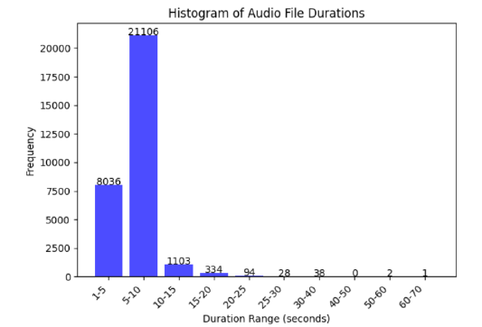
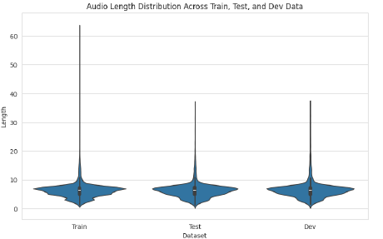
The above Violin plot displays the distribution of audio lengths across the train, test, and development (dev) datasets.
The histogram depicted above illustrates the distribution of audio file durations

Slide 9
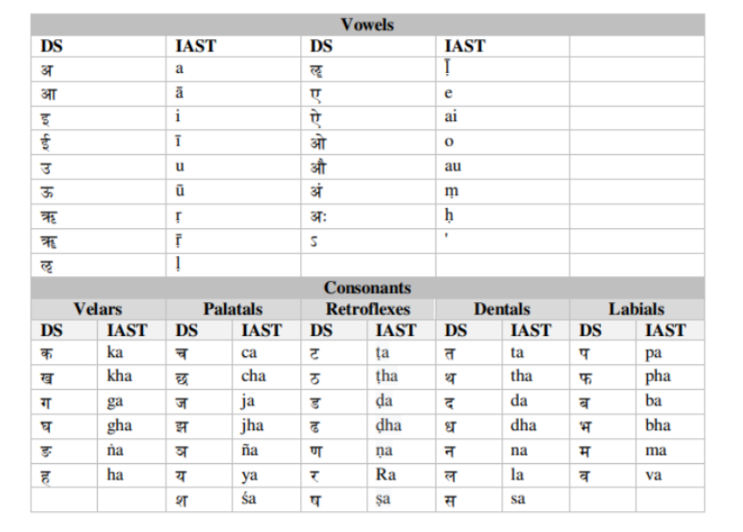
Transliterating Devanagari Script to IAST
I accurately transliterated the Devanagari text corresponding to every audio file into IAST format using the Python library ’indic-transliteration’.
Mapping Alphabet List in DS and IAST

Slide 10
Finetuning Wav2Vec 2.0
Preparing Tokenizer, Feature Extractor
1. Specifically, I worked with the XLRS-53 model, which requires a specialized tokenizer called Wav2Vec2CTCTokenizer
2. To transcribe speech accurately, a linear layer is added on top of the transformer block to classify each context representation into a token class.
3. The size of the output layer of this linear layer corresponds to the number of tokens in the vocabulary, which is defined based on the labeled dataset used for fine-tuning.
4. By establishing the vocabulary, I ensured that the tokenizer could accurately decode the model’s output classes into the corresponding transcription text

Slide 11
Preprocessing and Tokenization
1. Noticed the presence of special characters like ,.?!;:. I decided to remove them because these characters don’t correspond to distinct sound
2. To build the vocabulary, I opted to extract all distinct letters from the training and test data.
3. I also added a padding token, representing CTC’s ”blank token,” which is essential for the CTC
algorithm.
4. The CTC blank character makes it possible to filter out the duplicate characters. For example let’s look at the last word from the predicted sequence, _ER_RRR_ORR. Without the CTC blank token, the word looked like this:
ERRRRORR
5. If we were to simply remove duplicate characters, this would become EROR. That’s clearly not the correct spelling. But with the CTC blank token we can remove the duplicates in each group, so that:

Slide 12
_ER_RRR_ORR becomes _ER_R_OR
6. With the vocabulary comprising 43 tokens, including all letters of the alphabet and special characters like ”” and ’, I saved it as a JSON file.
7. Defined a data collator tailored to the XLRS model’s requirements. Unlike common data collators, this one treated input values and labels differently, applying separate padding functions to them.
8. The vocabulary size for the IAST text is determined to be 43. The model is trained on a 16 GB GPU, utilizing a batch size of 8 and a learning rate of 0.0001.

Slide 13

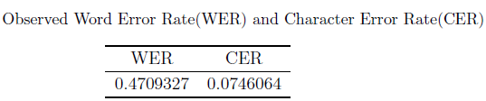
Results:
Word Error Rate: WER, derived from a comprehensive analysis of substitutions, insertions, and deletions relative to a reference transcription, provides a macro-level assessment of an ASR system’s accuracy.
Character Error Rate: In contrast, CER delves deeper, scrutinizing accuracy at the character level, thereby offering a more granular understanding of performance.

Slide 14
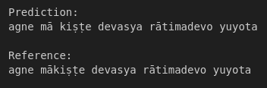
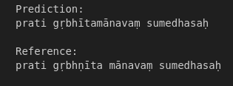
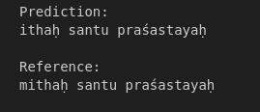

Slide 15
Conclusion:
1.After extensive training and meticulous refinement, I am proud to present the culmination of our efforts: an Automatic Speech Recognition (ASR) system tailored specifically for the Sanskrit language, leveraging the cutting-edge Wav2Vec2 architecture.
2. The successful deployment of this ASR system marks a significant milestone in advancing natural language processing for Sanskrit, opening doors to a wide range of applications, from educational tools to historical research.
3. As we look to the future, our ASR system stands as a testament to the potential of combining linguistic expertise with cutting-edge technology to preserve and promote the rich heritage of Sanskrit language and culture.
4. In conclusion, this project represents a harmonious synergy of tradition and innovation, empowering users to interact with Sanskrit language in unprecedented ways and paving the path for further advancements in speech recognition technology for underrepresented languages.

Slide 16
THANK YOU

